Slide 1
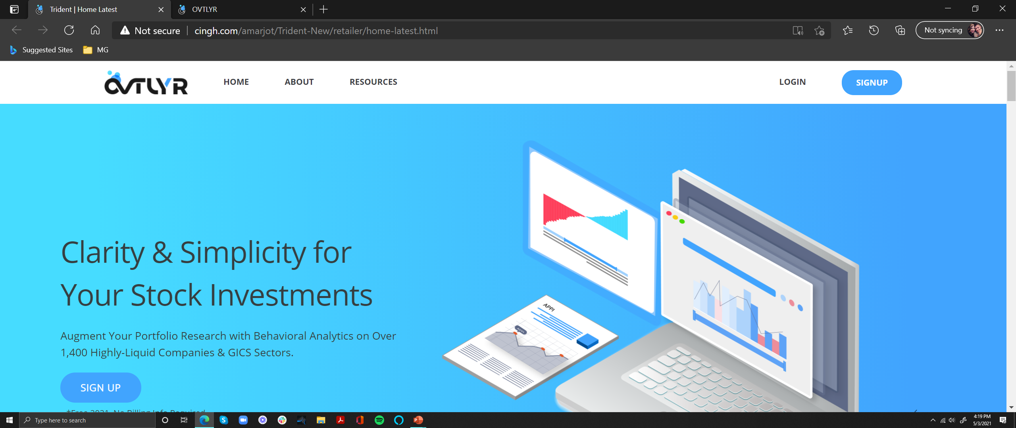


Clarity & Simplicity
For Your Stock Investments
Augment Your Portfolio Research with Behavioral Analytics on Over 1,400
Highly-Liquid Companies & GICS Sectors.
Free throughout 2021.
Sign Up
Can I Help?
Chatbot
Premium Vector | Set of cute robot ai character with circuits background (freepik.com)

Slide 2



Markets are People.
People are Predictable.
Humans are creatures of habit. We make decisions
around repeatable patterns and heuristics.
The data we create grows at an exponential rate and
conveys the ways we think & actions we will take.
Markets can be Irrational.
Irrationality Doesn’t have to be a Surprise.
OVTLYR’s unique AI captures diverse data to:
Uncover hidden cognitive biases.
Analyze the impact of behavioral factors on investments.
Predict where pockets of fear & greed create opportunities for our members.
Context is Crucial.
OVTLYR also provides financial data & breaking news, along with easy ways to identify and save relevant information helping to separate the signal from noise.
OVTLYR’s behavioral analytics are unique to fundamental & technical analysis. They can be layered onto existing strategies without the threat of over-weighting traditional sources.

Slide 3
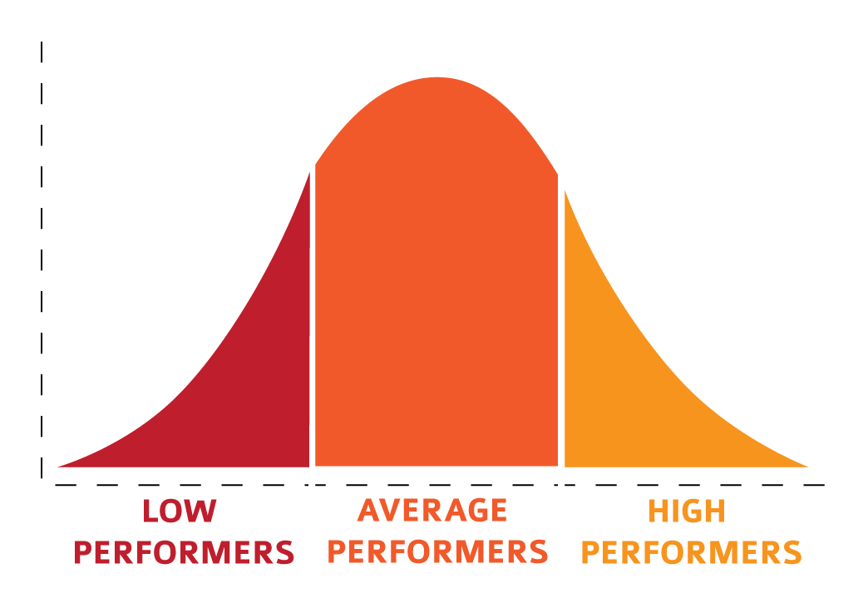



Who is OVTLYR For?
Members who are neither highly active nor completely passive have the most to gain. These are the investors too busy to
take on the lifestyle of a full-time trader but are also dissatisfied with holding through pronounced downturns in the market.
OVTLYR was designed to be responsive when you need it and low-hassle when you don’t.
If dollar-cost-averaging and regular rebalancing are in your comfort zone, you’ve come to the right place.
Ideal OVTLYR Community
Value
Too fast for positions to materialize
Unwilling to change with new information
Trading Frequency
Very Active Very Passive

Slide 4
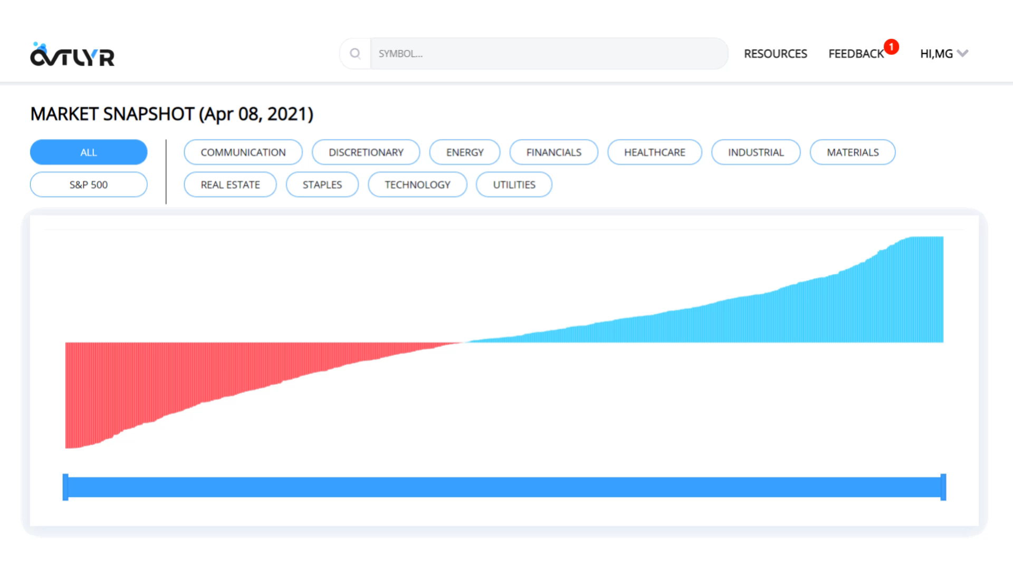

Features
Behavioral Analytics
The most comprehensive market behavioral data available condensed into intuitive trajectory prediction oscillators & observed movement heatmaps.
Fundamental Financials
Detailed visibility on essential balance sheet, cash flow and income statement fields.
News
Asset-specific breaking news when you need it: now!
Market Snapshots
Consolidated views of behavioral analytics for each GICS sector and broader coverage. Market cap & evenly-weighted versions available.
Discount & Premium Leaders
Short-cut to the best (and worst) opportunities materializing based on behavioral factors.
Watchlists
Follow your favorite companies quickly & easily!
Coverage
OVTLYR supports over 1,400 of the largest market cap, most liquid assets on the NYSE and NASDAQ exchanges. See the full list here.

Slide 5
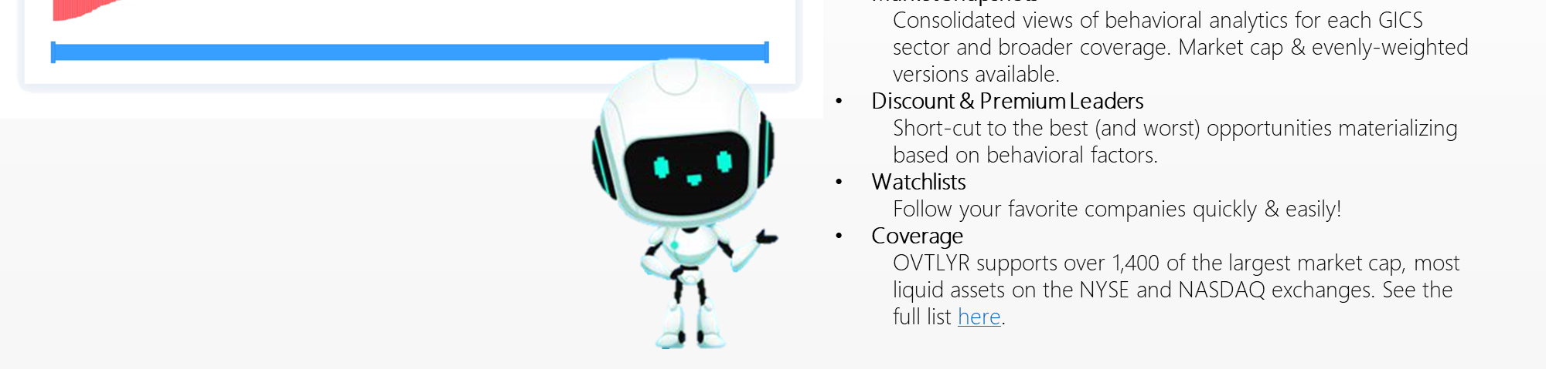

Try OVTLYR Absolutely FREE During Our Extended Pilot Launch Throughout 2021!
We’re still adding features for the final release, but that’s no reason not to use the already capable OVTLYR data to improve your equity positions.
Sign up with just an email. No billing info necessary!
No contracts, no obligations. Month-to-month billing for premium plans after 2021.
Join Our Pilot

Slide 6




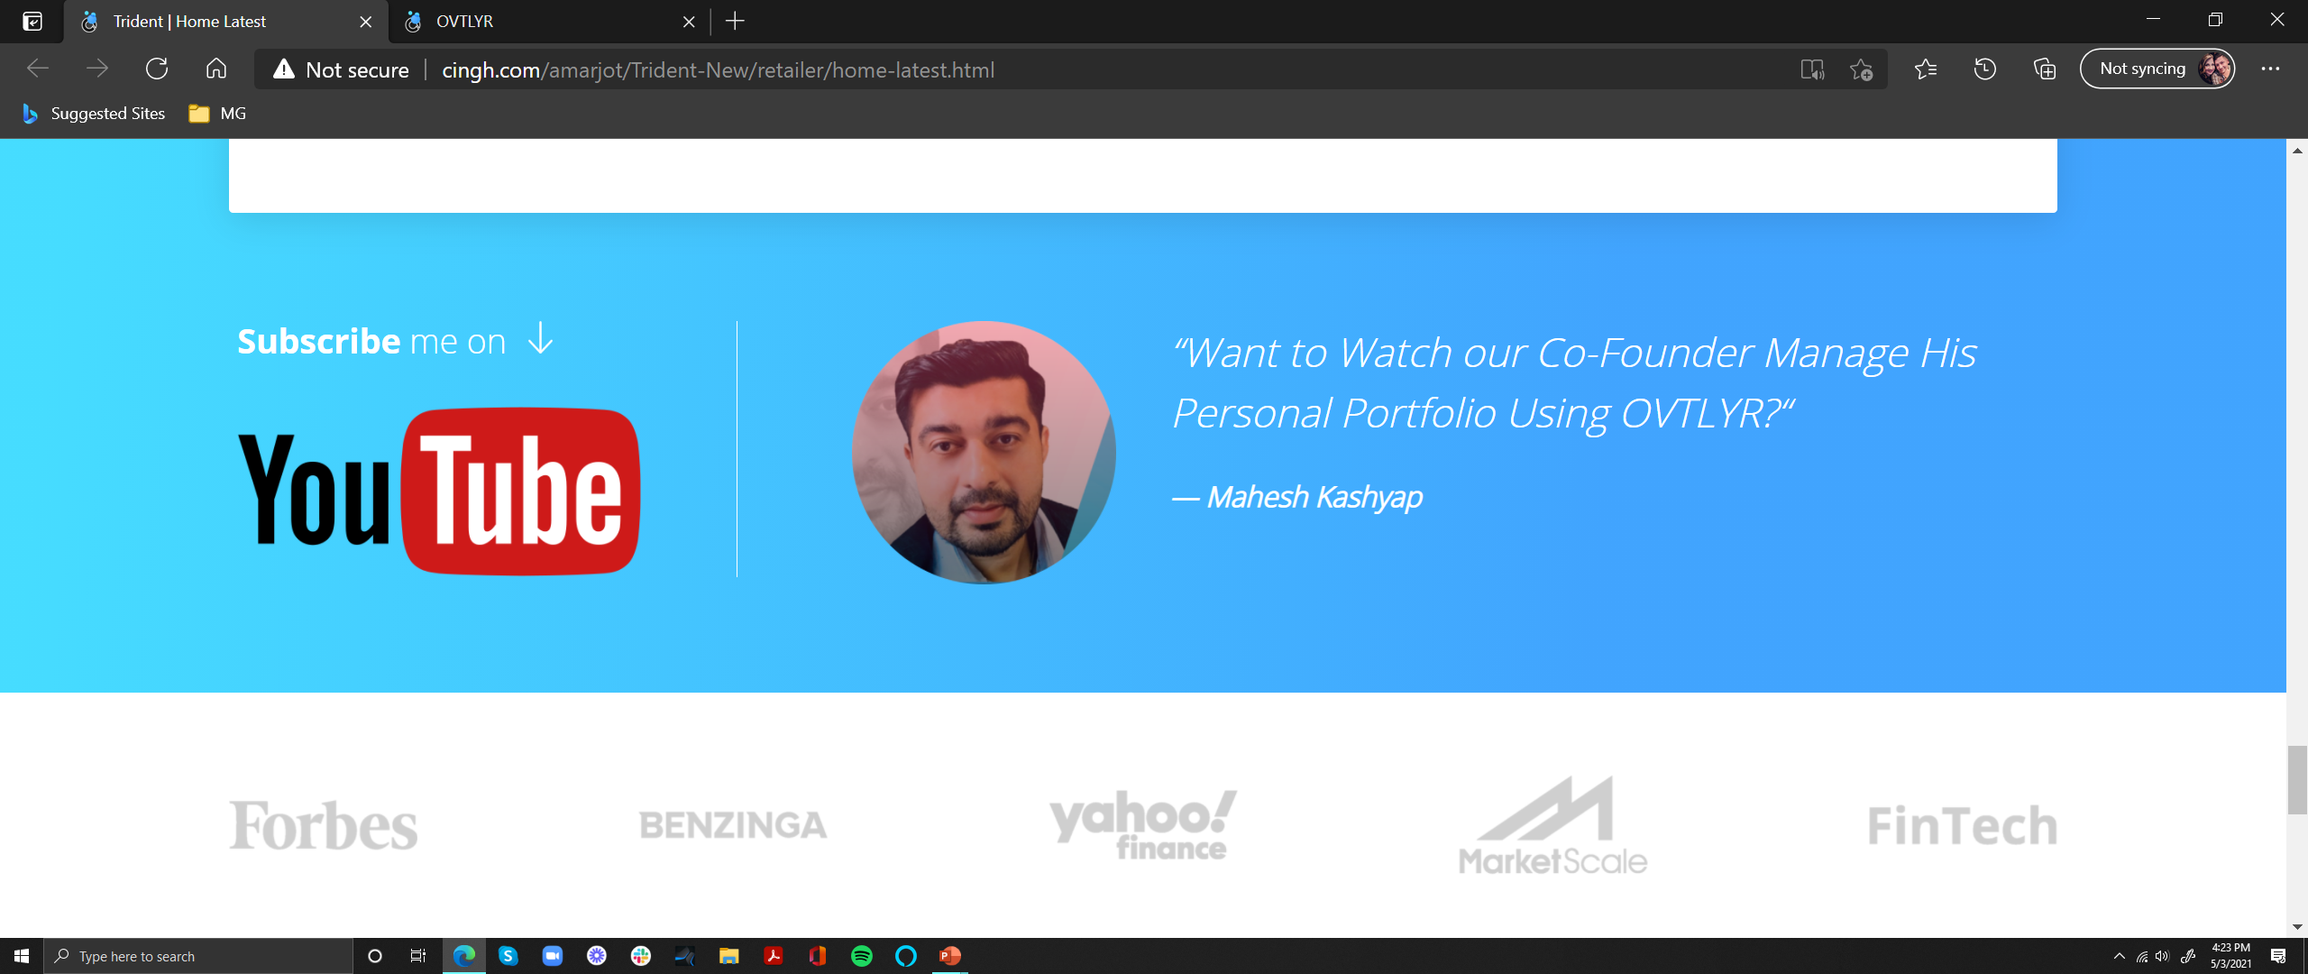
Because it’s time to democratize the power of behavioral analytics and fundamentally change the way we all manage our investments.
It’s easy to say, “buy low & sell high,” but it’s far
more difficult to do so when the pressure is on.
Why Make OVTLYR
Widely Available?
Feedback from our members helps us to build the solutions you want, the way you want it. We LOVE hearing from you!
We Need Your Help!
Want to Watch our Co-Founder
Mahesh Kashyap
Manage His Personal Portfolio Using OVTLYR?
Subscribe to me on

Slide 7

Frequently Asked Questions
1. What is Behavioral Finance?
Behavioral Finance is the study of how psychological influences impact market outcomes. It’s about knowing how over 200 cognitive biases affect the way you – and every other investor – approach the market.
Some of the measured biases OVTLYR behavioral analytics are derived from evolve incrementally, whereas others may shift dramatically (typically in conjunction with a major catalytic event, but not always). Datapoints are collected daily prior to running the trajectory prediction model, and likewise the portal is updated daily prior to market open.
2. Why are Behavioral Analytics Important?
3. What Does a Typical Position Duration with OVTLYR Look Like?
4. What do the Discount and Premium Lists Represent?
5. Will OVTLYR Help Me Identify Opportunities to Short a Stock?

Slide 8
6. Where Can I Learn More About How to Use OVTLYR?
7. Does OVTLYR “Re-Paint” Charts?
8. Why do I See a Different Close Price for a Stock on Another Website?
9. Why is Data Unavailable After a Stock Split?
10. Are there Certain Times when Data is Unavailable?
11. What Assets Does OVTLYR Cover?
12. Why Can’t I Find ____ Stock?

Slide 9
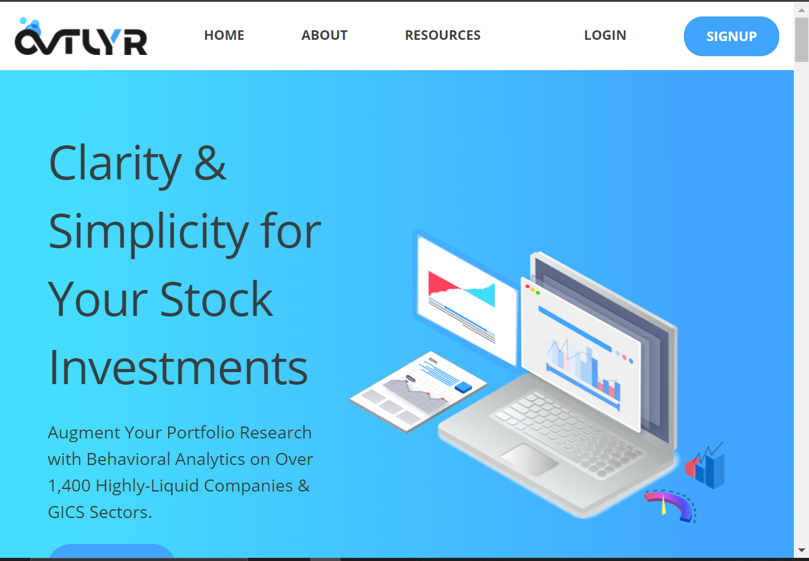
Clarity & Simplicity
For Your Stock Investments
Augment Your Portfolio Research with Behavioral Analytics on Over 1,400 Highly-Liquid Companies & GICS Sectors.
Sample above, flipped gradient. Left/below, how it currently appears (MS Edge). CTA button color change?
Logo = Dashboard -or- prompt to sign up; where will “About” navigate; add “Pricing” tab (free sign up, see EarningsWhispers.com for sample).

Slide 10
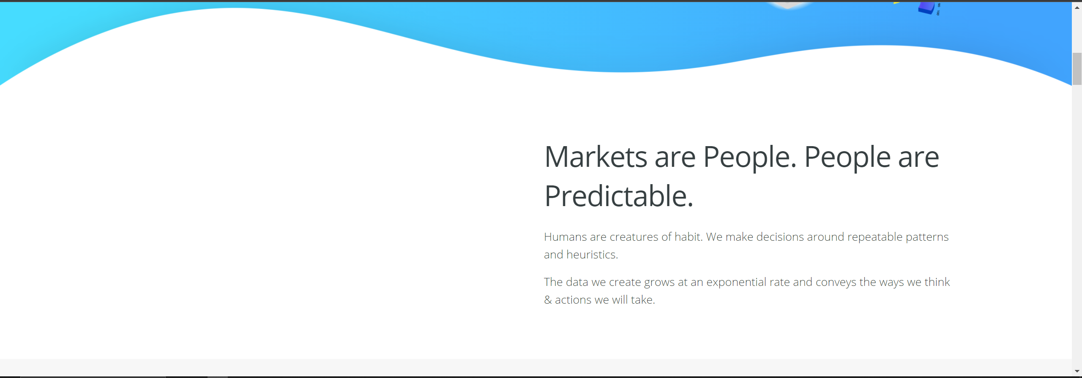
Image/video of “human behavior pattern” (i.e., cyclists moving together in traffic, people boarding a subway, etc.)
Markets are People.
People are Predictable.
Humans are creatures of habit. We make decisions
around repeatable patterns and heuristics.
The data we create grows at an exponential rate and
conveys the ways we think & actions we will take.

Slide 11
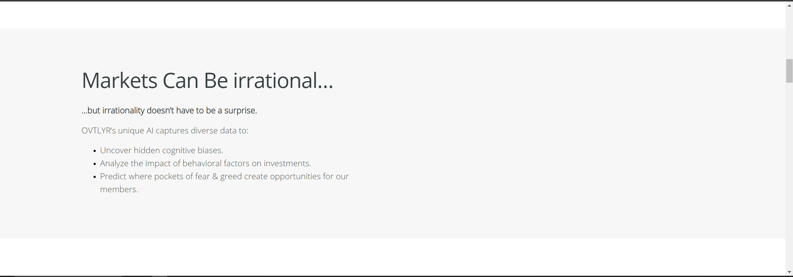
Markets can be Irrational.
Irrationality Doesn’t have to be a Surprise.
OVTLYR’s unique AI captures diverse data to:
Uncover hidden cognitive biases.
Analyze the impact of behavioral factors on investments.
Predict where pockets of fear & greed create opportunities for our members.
Image/video of “generic AI” (i.e., wireframe/node render of a brain)

Slide 12
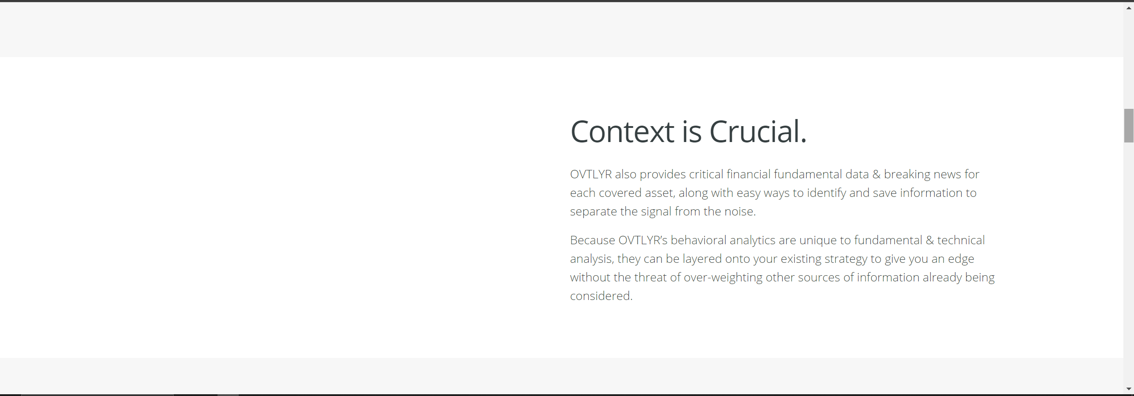
???
Context is Crucial.
OVTLYR also provides financial data & breaking news, along with easy ways to identify and save relevant information helping to separate the signal from noise.
OVTLYR’s behavioral analytics are unique to fundamental & technical analysis. They can be layered onto existing strategies without the threat of over-weighting traditional sources.

Slide 13
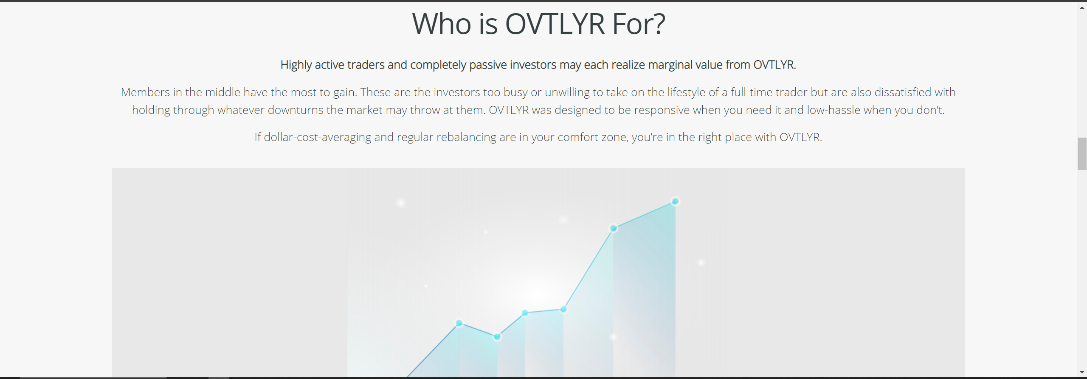
Who is OVTLYR For?
Members who are neither highly active nor completely passive have the most to gain. These are the investors too busy to
take on the lifestyle of a full-time trader but are also dissatisfied with holding through pronounced downturns in the market.
OVTLYR was designed to be responsive when you need it and low-hassle when you don’t.
If dollar-cost-averaging and regular rebalancing are in your comfort zone, you’ve come to the right place.

Slide 14
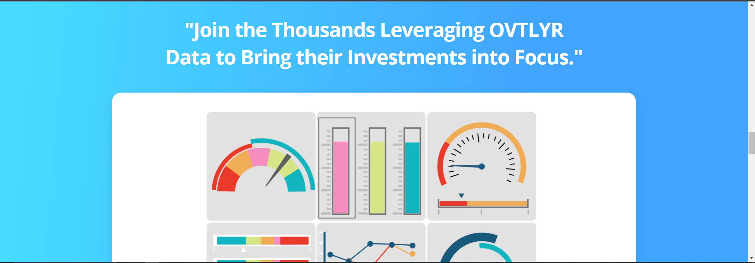
Video animation of features?
Possibly remove this section?

Slide 15
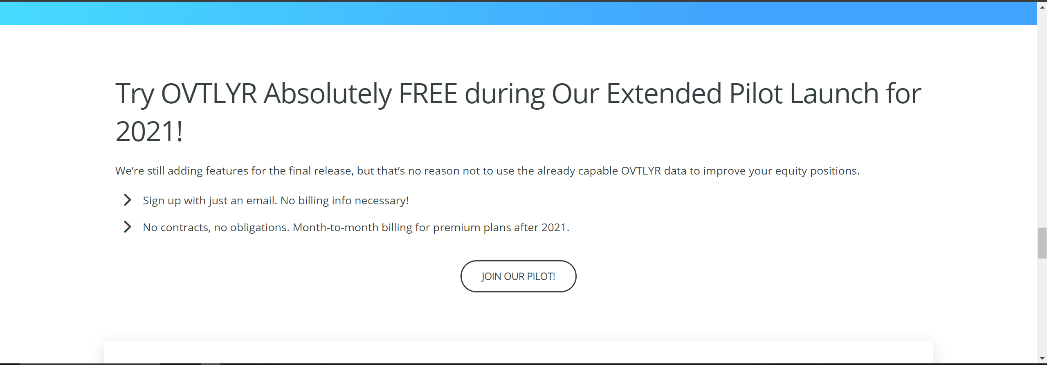
Minimal formatting change.

Slide 16
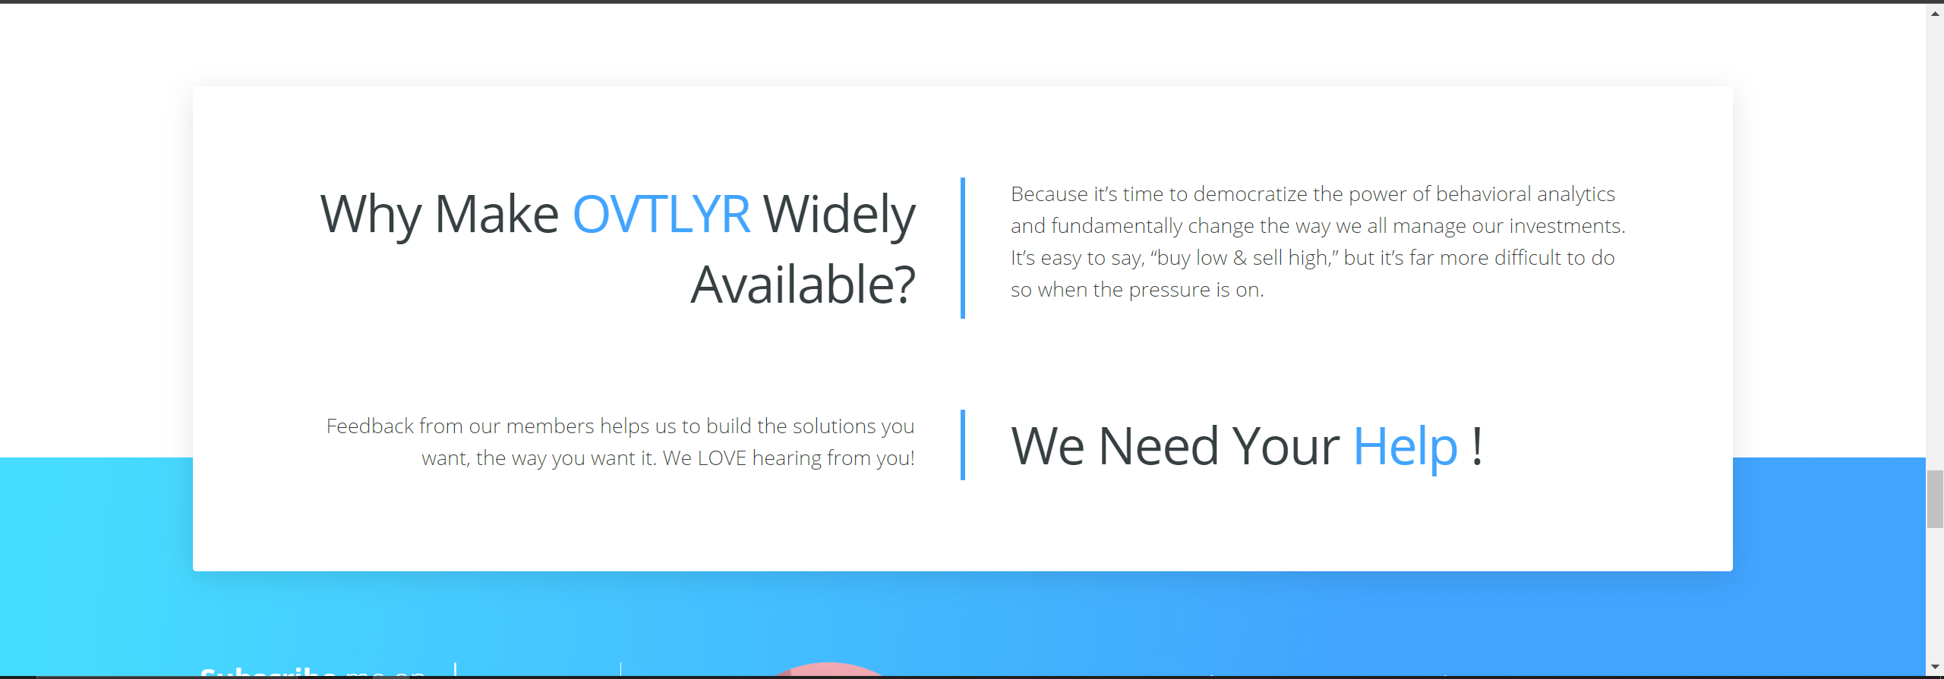
Minimal text change.

Slide 17
Minimal formatting & text change.

Slide 18
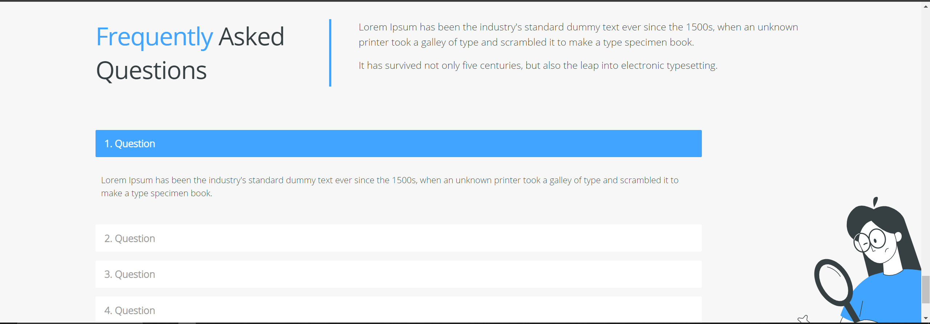
Complete list follows

Slide 19
What is Behavioral Finance?
Behavioral Finance is the study of how psychological influences impact market outcomes. It’s about knowing how over 200 cognitive biases affect the way you – and every other investor – approach the market.
Some of the measured biases OVTLYR behavioral analytics are derived from evolve incrementally, whereas others may shift dramatically (typically in conjunction with a major catalytic event, but not always). Datapoints are collected daily prior to running the trajectory prediction model, and likewise the portal is updated daily prior to market open.
Why are Behavioral Analytics Important?
Think of the market like a lion and everyone interacting with it a gazelle. Lions eat gazelles, but only from the back of the herd. Understanding where the “herd” is currently and the next direction it’s most likely to take is priceless when it comes to avoiding the lion’s claws & jaws.
Just as behavioral analytics require financial context to offer explainability, fundamental & technical analysis require visibility on market participant behaviors to fully identify opportunities that are both purposely contrarian and rational.
What Does a Typical Position Duration with OVTLYR Look Like?
Behaviors take time to manifest into opportunities, and the amount of time can fluctuate. There is no crystal ball for the stock market, but in thorough testing we have observed the following:
During periods of extreme volatility (or with generally more volatile assets), OVTLYR behavioral analytics reflect ideal holding periods of approximately a month on average.
During periods of reduced or average volatility, ideal holding periods may last several months, quarters, even beyond a year in some cases.
Please refer to the directional volatility histograms for additional visibility into the relationship between volatility and ideal holding times. [include text when feature is available]
What do the Discount and Premium Lists Represent?
OVTLYR will rank every symbol in our database. You can think of these rankings as the combined oscillator/heatmap value for a particular symbol. Symbols on the Discount side will typically have low oscillator values and a red heatmap while those on the Premium side will typically have high oscillator values and a blue heatmap.
Will OVTLYR Help Me Identify Opportunities to Short a Stock?
Please note: OVTLYR is optimized for long-only exposure. For example:
An asset may appear in the Premium list, indicating an irrationally high exuberance toward the asset and an opportunity to rebalance into other assets with a greater potential for appreciation. This does not necessarily mean the asset appearing on the Premium list is likely to depreciate significantly in the near future.
We strongly encourage OVTLYR members to review the relationships between the predictive trajectory oscillator, observed behavioral heatmaps and time elapsed for any asset they intend to take a position on.
Where Can I Learn More About How to Use OVTLYR?
Please visit our Resources directory HERE.
You may also join one of our periodic live webinar presentations. Sign up with just an email address, and we will email notices in advance. If you happen to miss a webinar you can catch the replay on YouTube along with other OVTLYR content.
At any time, you may contact us directly through the Feedback section of the portal, or by emailing us at support@ovtlyr.com.

Slide 20
If you prefer social media, you can find us on Facebook, Instagram and LinkedIn.
Does OVTLYR “Re-Paint” Charts?
Generally no. During the 2021 Pilot Program, there may be instances where significant improvements to our models and/or additional datasets going live may prompt a re-paint in order to better portray the historical impact of the given change. In these cases, we will communicate any alterations to historical charts in advance through both email and in the Updates section of the Resources menu so that you have time to collect data you consider relevant.
Why do I See a Different Close Price for a Stock on Another Website?
consensus on end-of-day pricing (such as those used to indicate closing price on OVTLYR heatmaps) is something of a myth. Often, differences can be attributed to adjustment methodology. While we do not fully know the unpublished methodologies used by other providers, OVTLYR follows the process outlined by Quandl HERE. This approach adds considerable visibility on the impact of corporate actions typically omitted by other sources, and we feel best serves the OVTLYR community.
Why is Data Unavailable After a Stock Split?
After a stock splits, we will temporarily take down the symbol to update our model and to avoid confusion. We are continually speeding up this process to reduce the amount of down time our members experience and appreciate your patience.
Are there Certain Times when Data is Unavailable?
Data does not populate during routine daily updates (typically 10:00pm-12:00pm CST) and returns an “Unavailable” message. This is being addressed, and data current as of the previous day will be visible during the overnight processing period once complete. We apologize for any inconvenience.
What Assets Does OVTLYR Cover?
OVTLYR is continually training and adding new symbols to the coverage list (typically made available in bulk with major updates). Over 1,400 of the largest market cap, most liquid single-names are supported at present. Names are chosen according to the following criteria:
Market capitalization (larger market caps receiving priority).
Diverse data availability.
Minimum longevity requirement.
It should be noted that assets failing to meet acceptable signal-to-noise ratio standards will be omitted from display.
The current complete coverage list is available HERE.
Why Can’t I Find ____ Stock?
The decision was made to make OVTLYR publicly available before every symbol had been trained so that members could begin to learn how to leverage our data. This is one of the many reasons we are running the free pilot through 2021.
Please note that assets which fail to meet minimum requirements for inclusion will be omitted until the requirements are met.

